Slide 1


Solution By: MKP Elites
PSID: INTL-SA-03
Team Leader Name:
Piyush Gupta
Notes:
FEEDBACK OF USERS TO BE GIVEN

Slide 2

Idea Introduction
IDENTIFICATION OF HATE CONTENT
- BASELINE
Tech Stack
1. Mongo DB
2.
3.
Resources Used
1. Google Colab
2.
3.
Any Third Party API/Services used
Yes
2. No
IDEA-OUTCOME – HEADLINE-
Tell us in Detail, what will be the possible outcome of your solution and how similar it is going to be in sync with actual problem statement

Slide 3


Our Approach Towards Idea SOLUTION IMG TO BE PUT HERE INSTEAD OF MACBOOK
Write Your Approach in Brief below
Write your approach and Agile method(if used) in development of solution, 4 liners will be enough
How you Targetted problem?
What Innovation or feature you added
Any functional requirement in further development ?
Notes:
Use any image of your proposed solution here instead of this macbook image

Slide 4

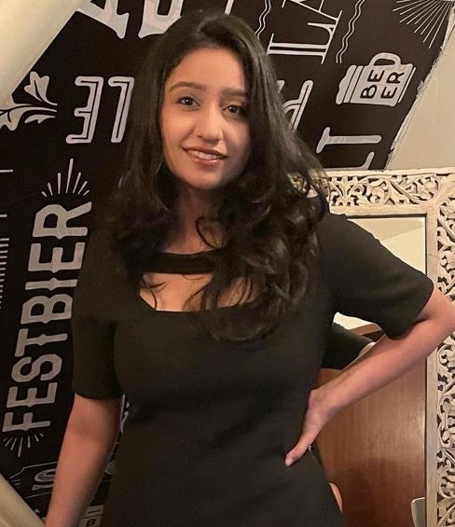




Meet the Team
PIYUSH GUPTA
B.E COMPUTER SCIENCE
SOPHOMORE
MAHIRA PURI
B.E COMPUTER SCIENCE
SOPHOMORE
SAIYAM ARORA
B.E COMPUTER SCIENCE
SOPHOMORE
BHAVYA KALRA
B.E COMPUTER SCIENCE
SOPHOMORE
AMIT SAXENA
B.E COMPUTER SCIENCE
SOPHOMORE

Slide 5
Development Pipeline
Documents To be prepared for installation and evaluation
1.
2.
3.
4.
Any Third party API used, if yes please specify
Proposed Development Plan in pointers
1.
2.
3.
4.
5.
6.
Repository Link or Any refrences link of folders
Proposed UI and functional flow in pointers
1.
2.
3.
4.
5.
Step A
Step B
Step C
Step D
Step E

Slide 6
Vision of Innovation/Idea/Solution
Explain How you developed Idea
How you idea is different and innovative form other ideas- a default comparison
How much time it will take in conversion as a final product
Any early stage innovation detected while developing the solution

